Slide 1



Nutrition Risk Assessment in
Critically ill Patients!
Daren K. Heyland
Professor of Medicine
Queen’s University, Kingston General Hospital
Kingston, ON Canada
Notes:
Add data from iatrogenic malnutrition slides

Slide 2
Statements like this are a problem!
“Our results suggest that, irrespective of the route of administration, the amount of macronutrients administered early during critical illness may worsen outcome.”
Cesar Am J Respir Crit Care Med 2013;187:247–255
“The most notable findings, however, were that loss of muscle mass not only occurred despite enteral feeding but, paradoxically, was accelerated with higher protein delivery..”
Batt JAMA Published online October 9, 2013
“Avoid mandatory full caloric feeding in the first week but rather suggest low dose feeding (e.g., up to 500 calories per day), advancing only as tolerated (grade 2B)..”
SSC Guidelines CCM Feb 2013

Slide 3
My Big Idea!
Underfeeding in some ICU patients results in increased morbidity and mortality!
Driven by misinterpretation of clinical data
Not all patients will benefit the same; need better tools to risk stratify
There are effective tools to overcome iatrogenic malnutrition

Slide 4
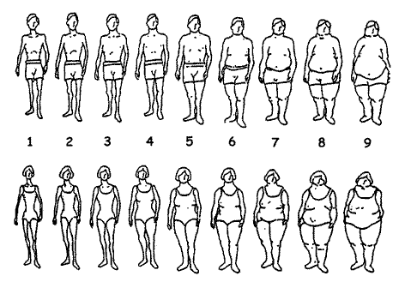
ICU patients are not all created equal…should we expect the impact of nutrition therapy to be the same across all patients?

Slide 5
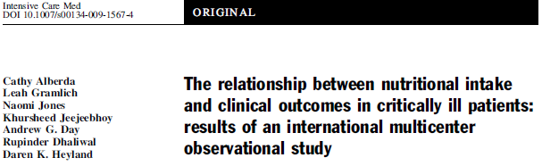
Point prevalence survey of nutrition practices in ICU’s around the world conducted Jan. 27, 2007
Enrolled 2772 patients from 158 ICU’s over 5 continents
Included ventilated adult patients who remained in ICU >72 hours

Slide 6
25%
50%
75%
100%

Slide 7

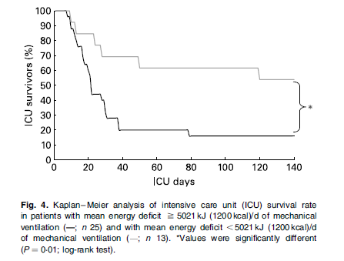
Mechancially Vent’d patients >7days (average ICU LOS 28 days)
Faisy BJN 2009;101:1079

Slide 8
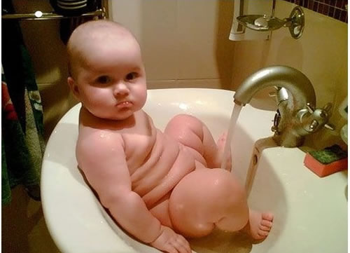
How do we figure out who will benefit the most from Nutrition Therapy?
Notes:
Need picture of malnourshed child

Slide 9
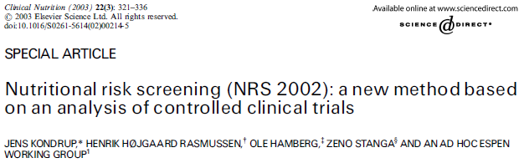
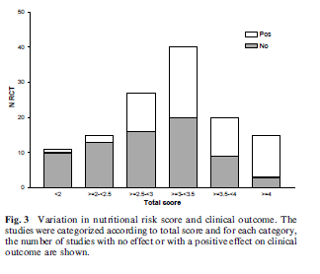

Slide 10
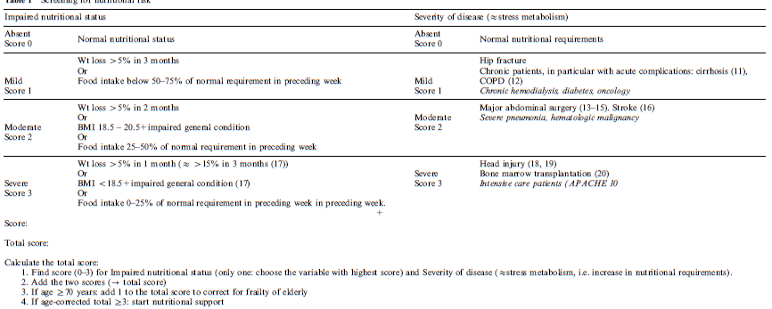
All ICU patients treated the same

Slide 11
Albumin: a marker of malnutrition?
Low levels very prevalent in critically ill patients
Negative acute-phase reactant such that synthesis, breakdown, and leakage out of the vascular compartment with edema are influenced by cytokine-mediated inflammatory responses
Proxy for severity of underlying disease (inflammation) not malnutrition
Pre-albumin shorter half life but same limitation

Slide 12
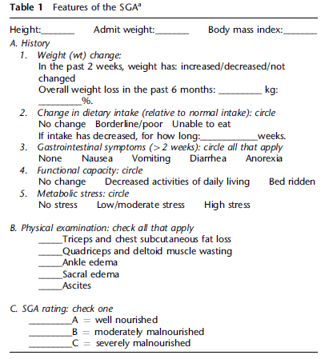
Subjective Global Assessment?

Slide 13
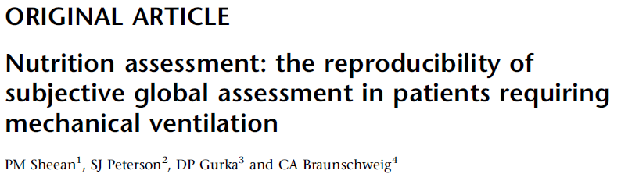
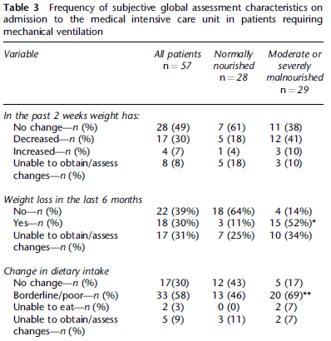
When training provided in advance, can produce reliable estimates of malnutrition
Note rates of missing data

Slide 14
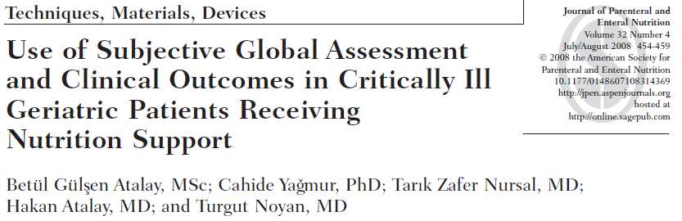
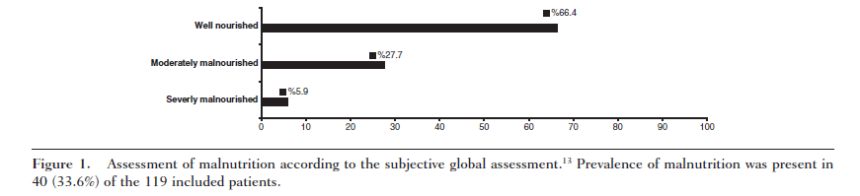
mostly medical patients; not all ICU
rate of missing data?
no difference between well-nourished and malnourished patients with regard to the serum protein values on admission, LOS, and mortality rate.

Slide 15
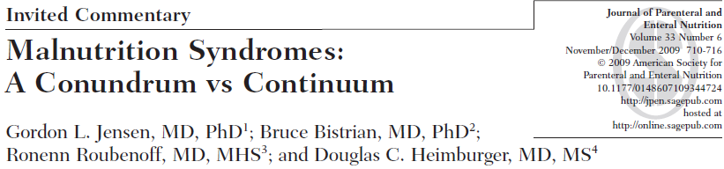
“We must develop and validate
diagnostic criteria for appropriate assignment of the
described malnutrition syndromes to individual patients.”

Slide 16
A Conceptual Model for Nutrition Risk Assessment in the Critically Ill
Acute
Reduced po intake
pre ICU hospital stay
Chronic
Recent weight loss
BMI?
Starvation
Nutrition Status
micronutrient levels - immune markers - muscle mass
Inflammation
Acute
IL-6
CRP
PCT
Chronic
Comorbid illness

Slide 17
The Development of the NUTrition Risk in the Critically ill Score (NUTRIC Score).
When adjusting for age, APACHE II, and SOFA, what effect of nutritional risk factors on clinical outcomes?
Multi institutional data base of 598 patients
Historical po intake and weight loss only available in 171 patients
Outcome: 28 day vent-free days and mortality
Heyland Critical Care 2011, 15:R28

Slide 18
What are the nutritional risk factors associated with clinical outcomes?
(validation of our candidate variables)
 | Non-survivors by day 28 (n=138) | Survivors by day 28 (n=460) | p values
Age | 71.7 [60.8 to 77.2] | 61.7 [49.7 to 71.5] | <.001
Baseline APACHE II score | 26.0 [21.0 to 31.0] | 20.0 [15.0 to 25.0] | <.001
Baseline SOFA | 9.0 [6.0 to 11.0] | 6.0 [4.0 to 8.5] | <.001
# of days in hospital prior to ICU admission | 0.9 [0.1 to 4.5] | 0.3 [0.0 to 2.2] | <.001
Baseline Body Mass Index | 26.0 [22.6 to 29.9] | 26.8 [23.4 to 31.5] | 0.13
Body Mass Index |  |  | 0.66
<20 | 6 ( 4.3%) | 25 ( 5.4%)
≥20 | 122 ( 88.4%) | 414 ( 90.0%)
# of co-morbidities at baseline | 3.0 [2.0 to 4.0] | 3.0 [1.0 to 4.0] | <0.001
Co-morbidity |  |  | <0.001
Patients with 0-1 co-morbidity | 20 (14.5%) | 140 (30.5%)
Patients with 2 or more co-morbidities | 118 (85.5%) | 319 (69.5%)
C-reactive protein¶ | 135.0 [73.0 to 214.0] | 108.0 [59.0 to 192.0] | 0.07
Procalcitionin¶ | 4.1 [1.2 to 21.3] | 1.0 [0.3 to 5.1] | <.001
Interleukin-6¶ | 158.4 [39.2 to 1034.4] | 72.0 [30.2 to 189.9] | <.001
171 patients had data of recent oral intake and weight loss
 | Non-survivors by day 28 (n=32) | Survivors by day 28 (n=139) | p values
% Oral intake (food) in the week prior to enrolment | 4.0[ 1.0 to 70.0] | 50.0[ 1.0 to 100.0] | 0.10
% of weight loss in the last 3 month | 0.0[ 0.0 to 2.5] | 0.0[ 0.0 to 0.0] | 0.06

Slide 19
The Development of the NUTrition Risk in the Critically ill Score (NUTRIC Score).
Variable | Range | Points
Age | <50 | 0
 | 50-<75 | 1
 | >=75 | 2
APACHE II | <15 | 0
 | 15-<20 | 1
 | 20-28 | 2
 | >=28 | 3
SOFA | <6 | 0
 | 6-<10 | 1
 | >=10 | 2
# Comorbidities | 0-1 | 0
 | 2+ | 1
Days from hospital to ICU admit | 0-<1 | 0
 | 1+ | 1
IL6 | 0-<400 | 0
 | 400+ | 1
AUC | 0.783
Gen R-Squared | 0.169
Gen Max-rescaled R-Squared | 0.256
BMI, CRP, PCT, weight loss, and oral intake were excluded because they were not significantly associated with mortality or their inclusion did not improve the fit of the final model.

Slide 20
The Validation of the NUTrition Risk in the Critically ill Score (NUTRIC Score).

Slide 21
The Validation of the NUTrition Risk in the Critically ill Score (NUTRIC Score).

Slide 22
The Validation of the NUTrition Risk in the Critically ill Score (NUTRIC Score).
Interaction between NUTRIC Score and nutritional adequacy (n=211)*
P value for the interaction=0.01
Heyland Critical Care 2011, 15:R28

Slide 23
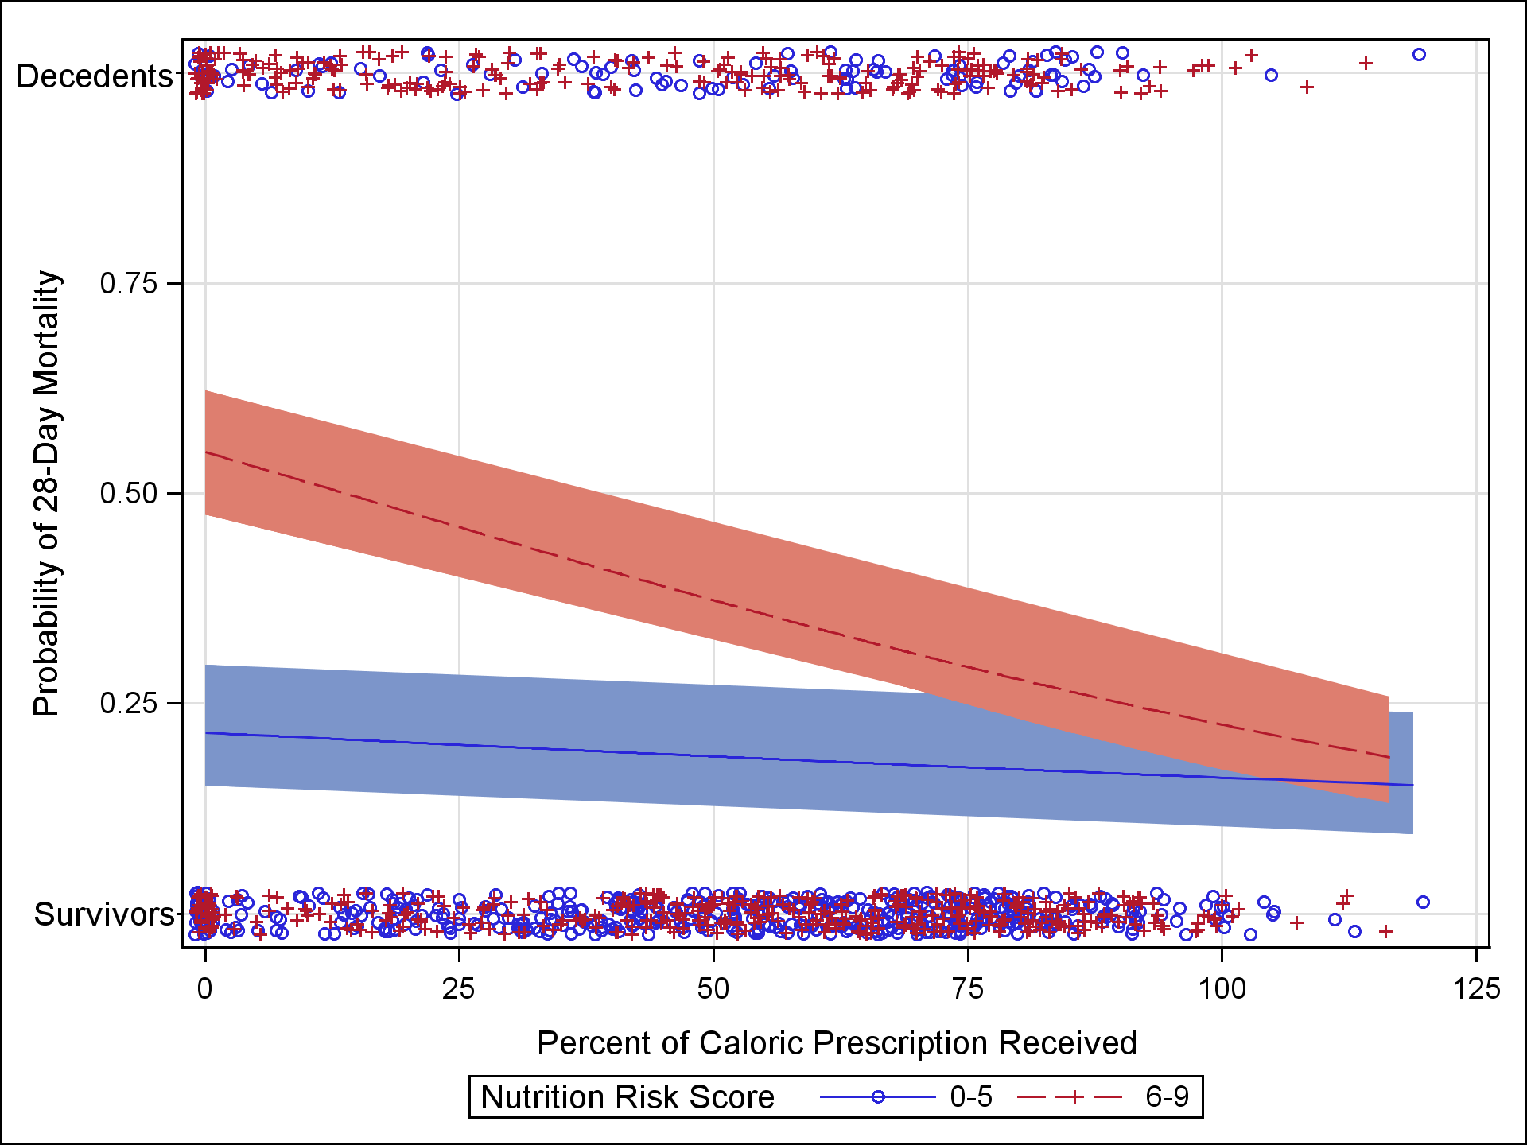
Further validation of the “modified NUTRIC” nutritional risk assessment tool
In a second data set of 1200 ICU patients
Minus IL-6 levels
Rahman
Clinical Nutrition 2015

Slide 24
Validation of NUTRIC Score in
Large International Database
>2800 patients from >200 ICUs
Protein
Calories
^Faster time-to-discharge alive with more protein and calories ONLY in the high NUTRIC group
Compher (in submission)

Slide 25
Translation and adaptation of the NUTRIC Score into the Portuguese language to identify critically ill patients at risk of malnutrition
The prevalence of patients with high score and likely to benefit from aggressive nutritional intervention in 4 Brazilian ICUs was 54% (95% CI 0.40 – 0.67).
Rosa, Marcadenti et al., posted on our CCN website

Slide 26

Optimal Nutrition (>80%) is associated with Optimal Outcomes!
(For High Risk Patients)
If you feed them (better!)
They will leave (sooner!)

Slide 27
ICU patients are not all created equal…should we expect the impact of nutrition therapy to be the same across all patients?

Slide 28
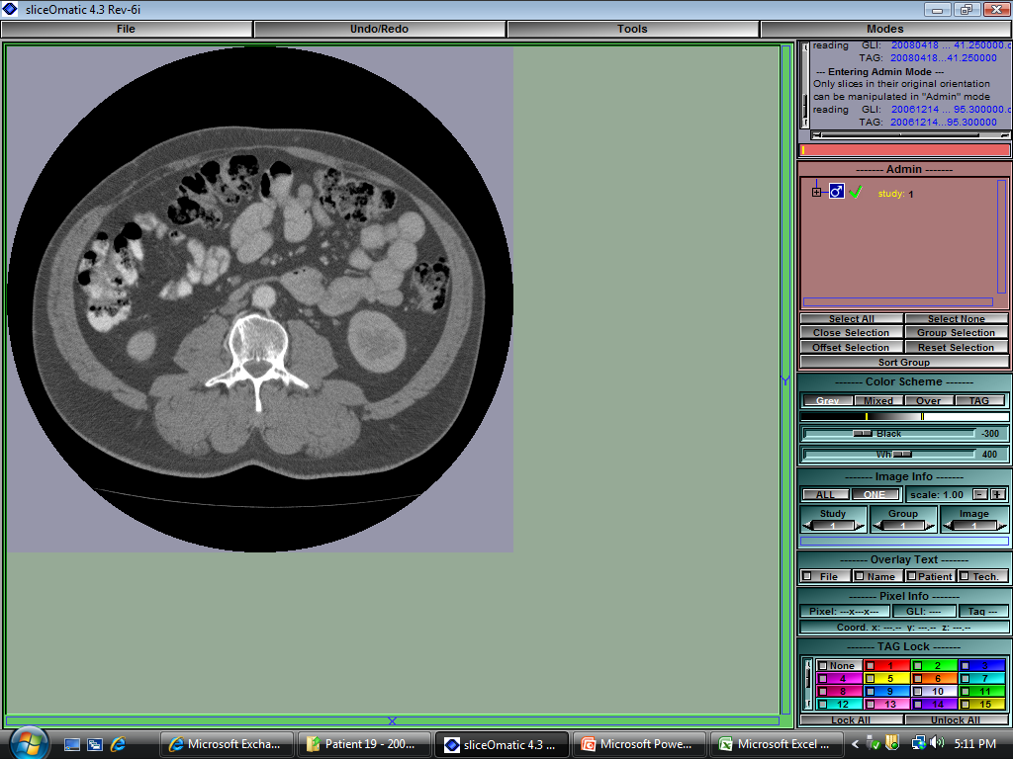
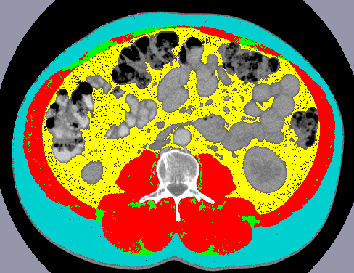
Body Composition Lab
CT Imaging Analysis
Skeletal Muscle
Adipose Tissue
Notes:
To date we have used weight/BMI as a descriptor of patient body composition and we have looked at change in weight as a marker of change in nutritional status or to evaluate success/failure of nutritional intervention
However, with weight, we cannot discern specific body composition profile or changes in profile;
Use of already existing CT scans can provide this information…
-L3 bony landmark – literature; longitudinal

Slide 29
Physical Characteristics of Patients
N=149 patients
Median age: 79 years old
57% males
ISS: 19
Prevalence of sarcopenia: 71%
Kozar Critical Care 2013

Slide 30
BMI Characteristics
 | All Patients | Sarcopenic Patients (n=106) | Non-sarcopenic Patients (n=43)
BMI (kg/m²) | 25.8 (22.7, 28.2) | 24.4 (21.7, 27.3) | 27.6 (25.5, 30.4)
Underweight, % | 7 | 9 | 2
Normal Weight, % | 37 | 44 | 19
Overweight, % | 42 | 38 | 51
Obese, % | 15 | 9 | 28
No correlation with BMI and Sarcopenia

Slide 31
Low muscle mass associated with mortality
 | Proportion of Deceased Patients | P-value
Sarcopenic patients | 32% | 0.018
Non-sarcopenic patients | 14%

Slide 32
Muscle mass is associated with ventilator-free and ICU-free days
 | All Patients | Sarcopenic Patients | Non-Sarcopenic Patients | P-value
Ventilator-free days | 25 (0,28) | 19 (0,28) | 27 (18,28) | 0.004
ICU-free days | 19 (0,25) | 16 (0,24) | 23 (14,27) | 0.002

Slide 33
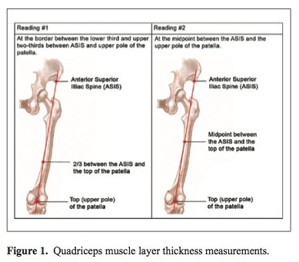
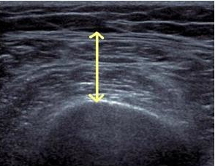
ICU Expedient Method
Tillquist et al JPEN 2013
Gruther et al J Rehabil Med 2008
Campbell et al AJCN 1995

Slide 34
VALIDation of bedside Ultrasound of Muscle layer thickness of the quadriceps in the critically ill patient: The VALIDUM Study
In a critically ill population, we aim:
To evaluate intra- and (inter-) rater reliability of using ultrasound to measure QMLT.
To compare US-based quadriceps muscle layer thickness (QMLT) with L3 skeletal muscle cross-sectional area using CT.
To develop and validate a regression equation that uses QMLT acquired by ultrasound to predict whole body muscle mass estimated by CT
Notes:
Last night I introduced a validation study on US and DXA in healthy – here we examine ICU based US and CT

Slide 35
Study Design and Population
Prospective, observational study
Heterogeneous population of ICU inpatients
US performed within 72 hrs of CT scan
Inclusion Criteria:
  Abdominal CT scan performed for clinical reasons <24 hrs before or <72 hrs after ICU admission
Exclusion Criteria:
  Moribund patients with devastating injuries and not expected to survive

Slide 36
Participant Characteristics (n=149)
Characteristics | All patients (n=149)
Age (years) | 59±19 (18-96)
Sex
Male | 86 (57.7%)
BMI (kg/m²)* | 29± 8 (17-57)
Underweight | 4 (2.7%)
Normal | 43 (28.9%)
Overweight | 46 (30.9%)
Obesity class I | 56 (37.6%)
APACHE II score | 17± 8 ( 2-43)
SOFA score | 5± 4 ( 0-18)
Charlson comorbidity index | 2± 2 ( 0- 7)
Functional comorbidity index | 1± 1 ( 0- 4)
Admission type
Medical | 87 (58.4%)
Surgical | 62 (41.6%)
Primary ICU admission
Cardiovascular/Vascular | 16 (10.7%)
Respiratory | 10 (6.7%)
Gastrointestinal | 26 (17.4%)
Neurologic | 6 (4.0%)
Sepsis | 56 (37.6%)
Trauma | 23 (15.4%)
Metabolic | 1 (0.7%)
Hematologic | 5 (3.4%)
Other | 6 (4.0%)
ICU mortality | 13 (8.7%)
Hospital mortality | 17 (11.4%)
Notes:
Of the n=191, 149 had usable CT scans, within the correct timeframe. As well as US performed within 72 hrs of CT scan.

Slide 37
Reliability results
Intra-rater reliability of QMLT (n=119)*
  Between subject variance: 0.45
  Within Subject variance: 0.01
  ICC (intra-class correlation coefficient): 0.98
Inter-rater reliability of QMLT (n=29)
  Between subject variance: 0.42
  Within Subject variance: 0.03
  ICC (intra-class correlation coefficient): 0.94
Notes:
*Note: Not all patients had a repeat measurement and there was no restriction that the ultrasound had to be within 3 days of a CT scan for this analysis. This is why the “n” is different than above. Only the first observation pair was used in patients with multiple repeat observations.

Slide 38
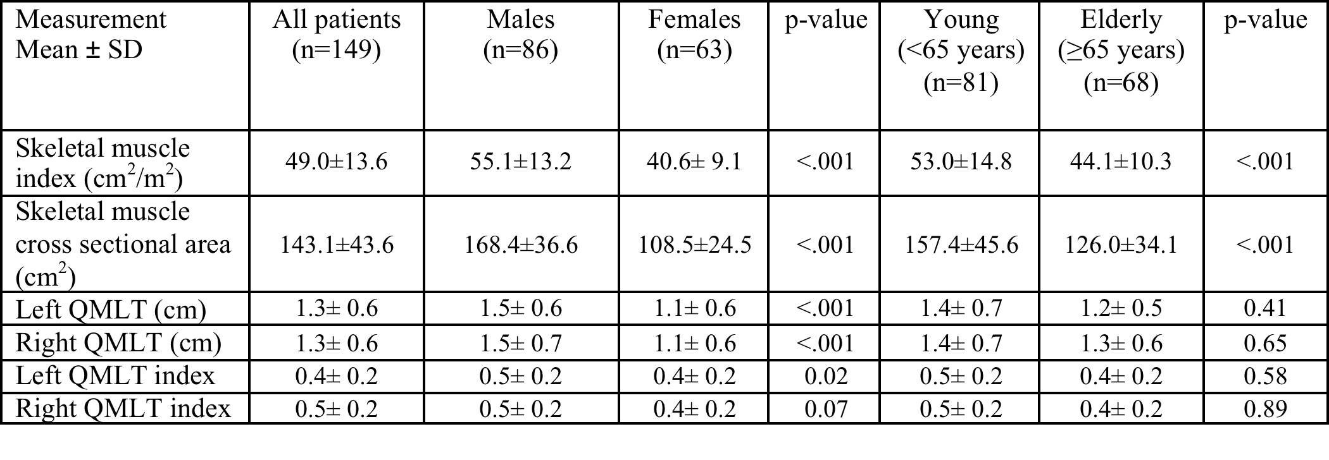
  Descriptive summary of CT skeletal muscle mass and QMLT by sex and age
50% prevalence of low muscularity defined by CT Threshold of <55.4 cm2/m2 for males and <38.9 cm2/m2 for females
Notes:
Describe the different measures
Why we included cm2/m2 as well as cm2 – becomes important in our results here as well as the BIA results
QMLT – the measures are v.low compared to non-Icu literature – but max compression used here…
QMLT – index – normalized to height squared – we have done this for consistency – is it redundant? Since we are evaluating pairs? Other papers have used limb length to formulate the thigh as a cylinder (which we don’t have but height might be the closest thing to it) → others have multiplied by limb length (and have resulted in stronger correlations)
- Difference between young and elderly may be driven by distribution of males and females in each group – we haven’t analyized this.
Skeletal muscle index (cm²/m²)
Calculated as Muscle CSA as cm2 divided by patient height squared as m2
Estimated whole body muscle mass (kg)
We have a regression equation that we use for this - it is not identified on the excel sheet
Left QMLT (cm)
Ultrasound-based quadricep muscle thickness in cm for the left leg
Right QMLT (cm)
Ultrasound-based quadricep muscle thickness in cm for the right leg
Left QMLT index
LEFT QMLT index divided by patient height squared in m2
Right QMLT index
RIGHT QMLT index divided by patient height squared in m2

Slide 39
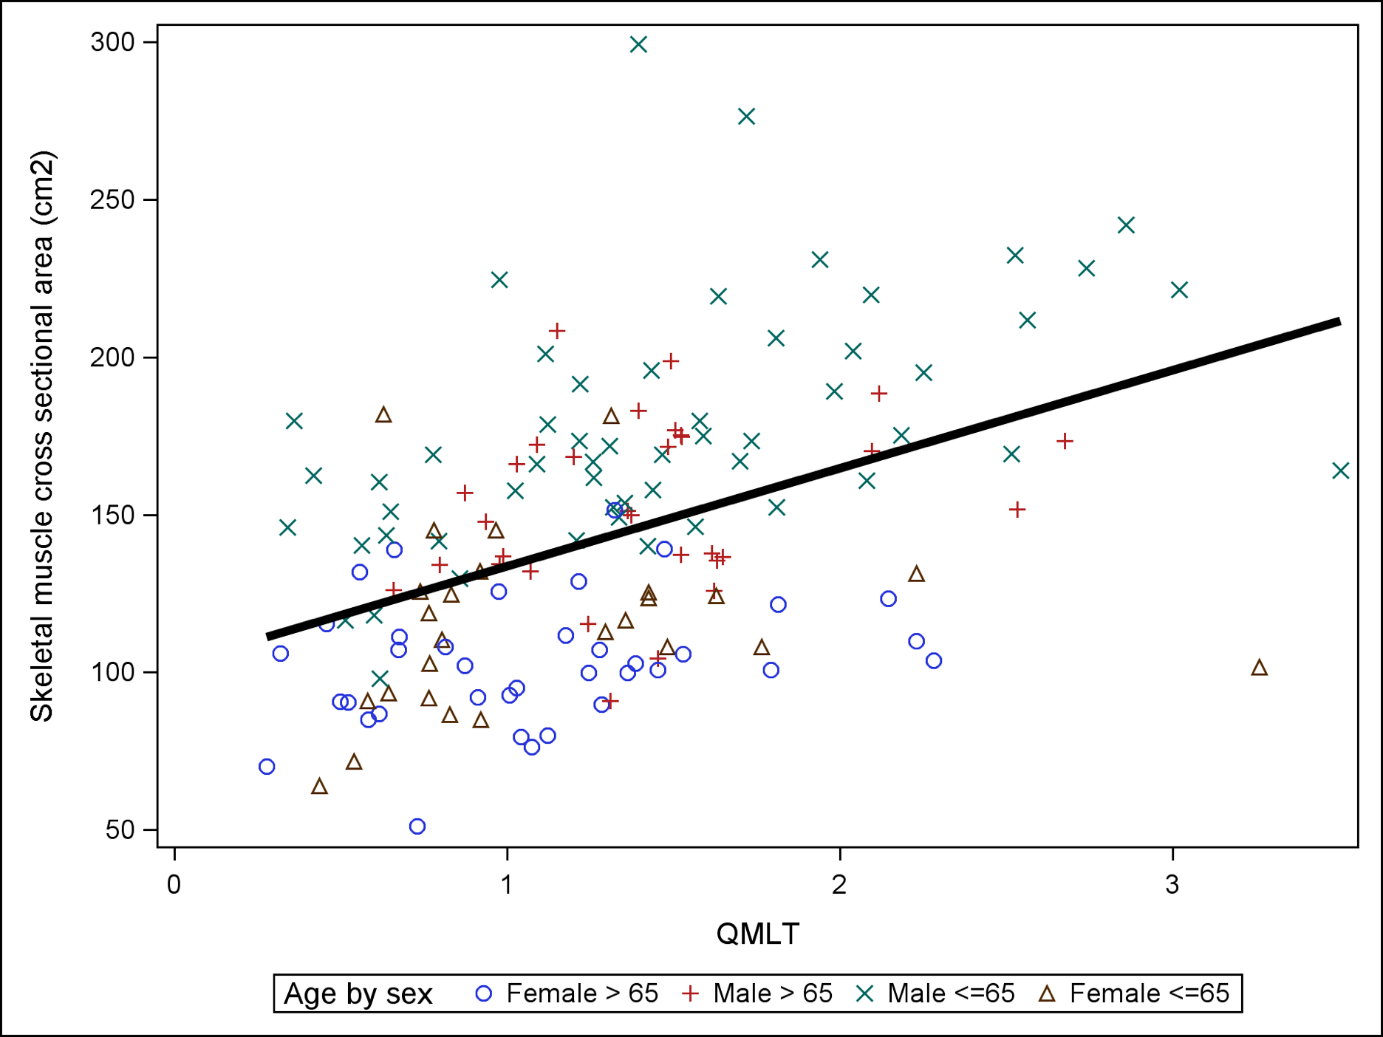
Association between CT skeletal muscle CSA and US QMLT
Pearson correlation coefficient = 0.45
P<0.0001
Notes:
Legend: Association between CT skeletal muscle cross sectional area and ultrasound QMLT with linear regression lines superimposed. Overall regression fit: CT skeletal muscle cross sectional area=102.5+31.1*QMLT. Overall Pearson correlation coefficient between CT skeletal muscle cross sectional area and Ultrasound QMLT index is 0.45, p<0.0001
Correlations were performed on each group but only males <65 yrs showed r=0.51 and P<0.05 (however this is likely driving the entire regression; n=?? but broad spectrum of muuscularity)
*Note: included 4 separate groups on the plot (young female, elderly female, young male, elderly male)
Groups
n
Pearson correlation coefficient
p values
Elderly males (≥ 65 yrs)
31
0.24
0.19
Young males (<65 yrs)
55
0.51
<0.0001
Elderly females (≥ 65 yrs)
37
0.26
0.12
Young females (<65 yrs)
26
0.13
0.52

Slide 40
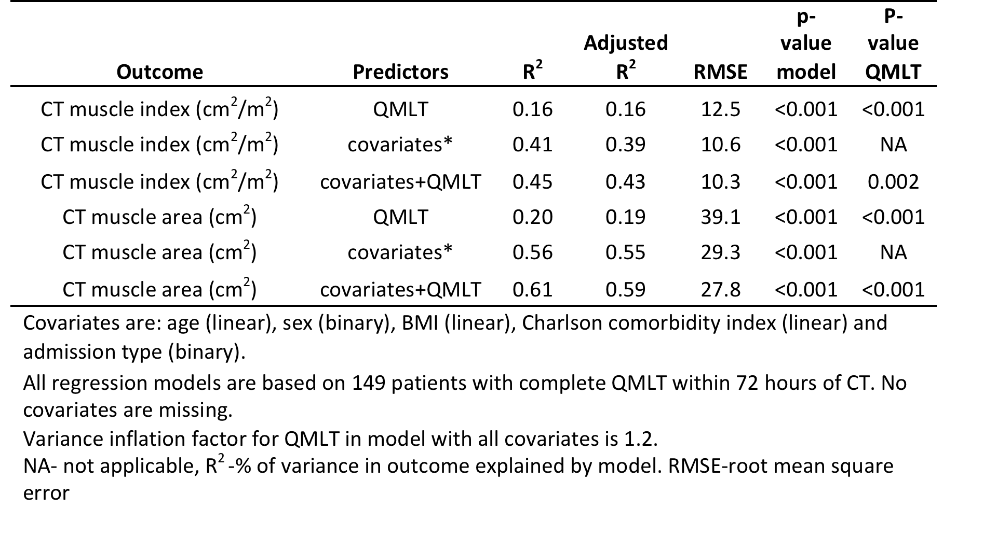
    Ability of QMLT to predict CT skeletal muscle index and CSA by linear regression
Notes:
Correlation is remarkably improved with covariates- however, it also suggests that covariates alone have a similar prediction for CT muscularity.

Slide 41
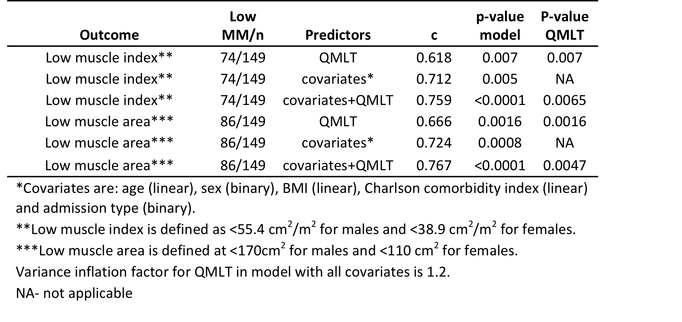
    Ability of QMLT to predict low CT skeletal muscle index and CSA by logistic regression
Notes:
Model is considered reasonable when c>0.7; strong when c>0.8 – moderately strong when combined covariates and QMLT – similar to previous slide using linear regression

Slide 42
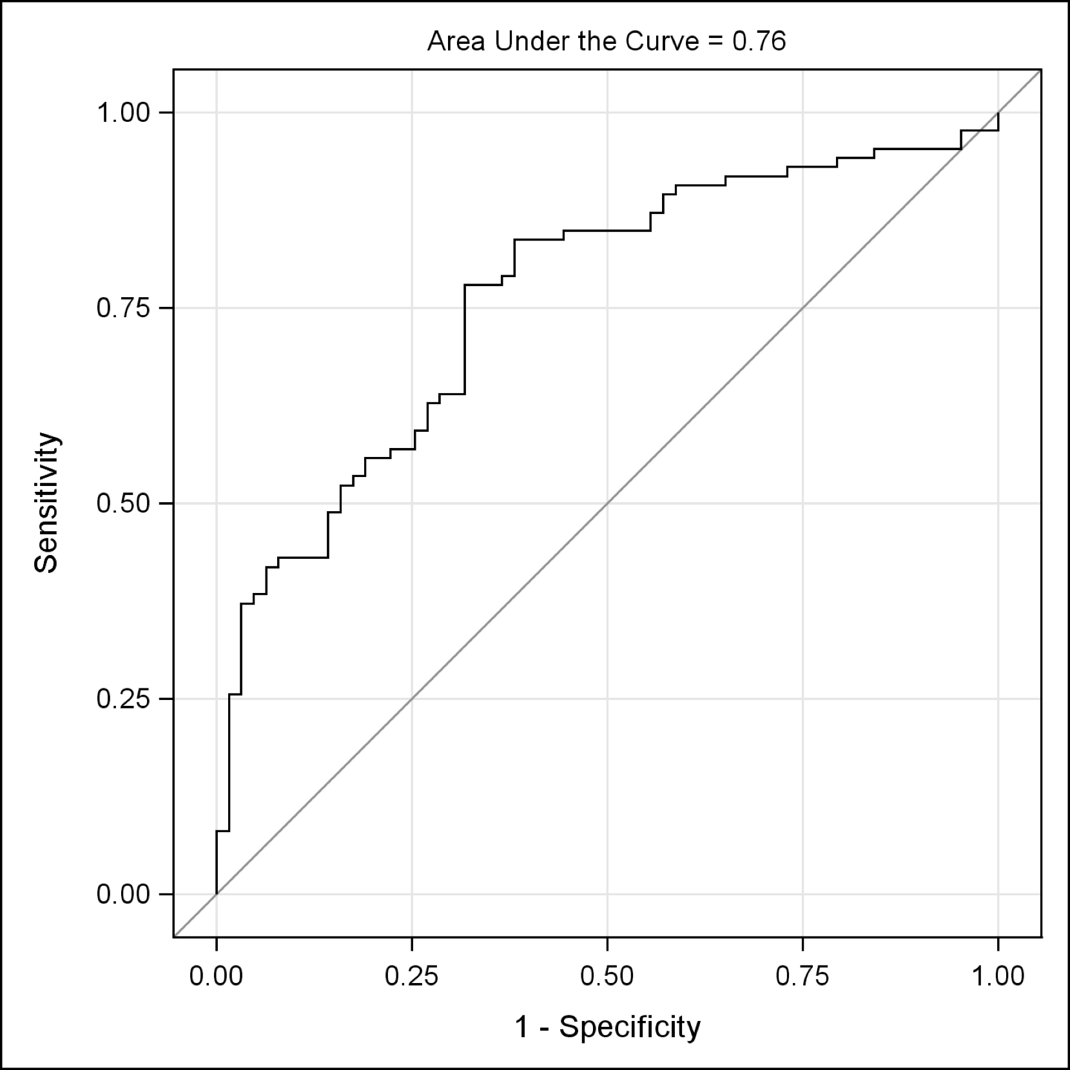
    ROC Curve of model with QMLT and covariates to predict low CT skeletal muscle area
Notes:
.90-1 = excellent (A)
.80-.90 = good (B)
.70-.80 = fair (C)
.60-.70 = poor (D)
.50-.60 = fail (F)

Slide 43
Summary
Underfeeding in some ICU patients results in increased morbidity and mortality!
Driven by misinterpretation of clinical data
Not all patients will benefit the same; need better tools to risk stratify

Slide 44
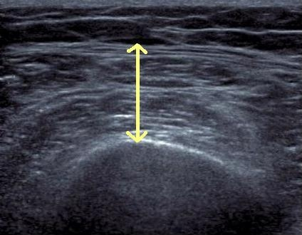
Who might benefit the most from nutrition therapy?
High NUTRIC Score?
Clinical
  BMI
  Projected long length of stay
  Nutritional history variables
Sarcopenia
  CT vs. bedside US
Others?

